Slide 1
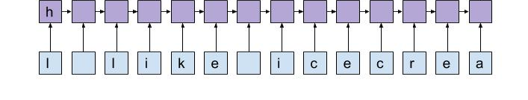
Character-level neural networks
Angus Fong

Slide 2
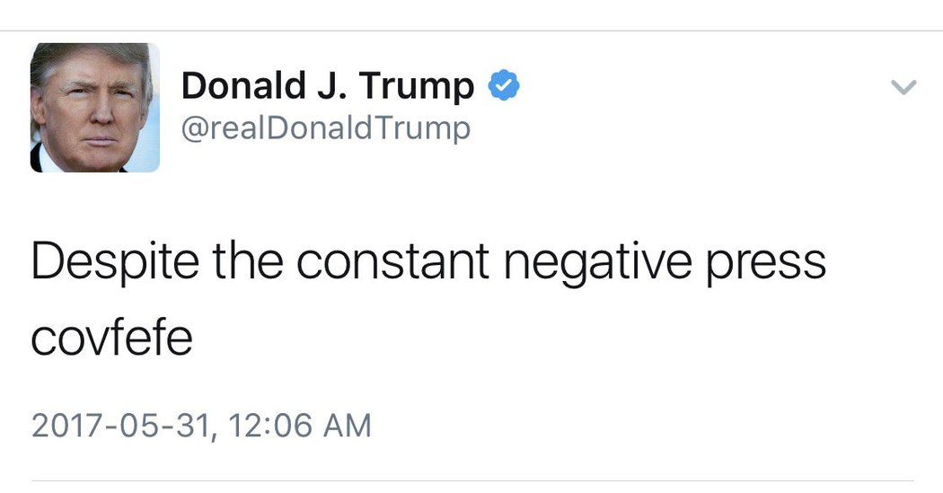
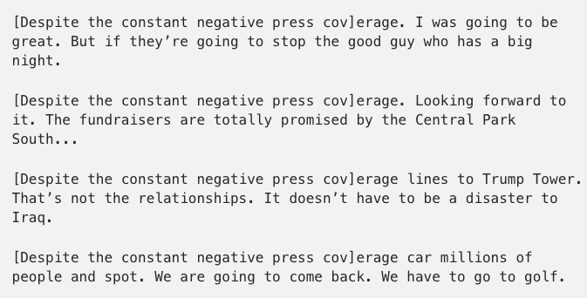
Demystifying covfefe with RNN’s
(https://towardsdatascience.com/yet-another-text-generation-project-5cfb59b26255)
Notes:
Karpathy - demystifying “covfefe”
Given seed, and language model, generate text
Trump Twitter Archive (~32000 tweets starting in 2009).
3.5 million characters. Not large!
The character “vocabulary” is fixed to the 98 printable ASCII characters

Slide 3
Why character level?
Less domain knowledge required (eg. co-occurrences)
Sub-word morphological information
Vocabulary limitations
Parameter efficiency
Notes:
Last is maybe a little less intuitive to you?

Slide 4
Outline
Character RNN basics
Paper 1: Character-aware neural language models
Paper 2: Character-level convolutional nets for text classification
Paper 3: Fully character-level neural machine translation without explicit segmentation
(If time) Paper 4: Character-level language modeling with hierarchical RNN’s
Discussion
Notes:
Paper 1 is old but set the ground for very interesting work on characters

Slide 5

Neural networks and sequential processing
(http://karpathy.github.io/2015/05/21/rnn-effectiveness/)
Notes:
ConvNets and RNN’s both used - ConvNets in more detail in papers.
RNN’s process different kinds of sequences.

Slide 6
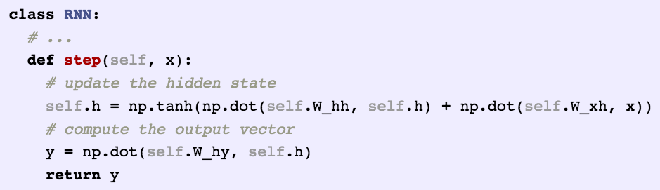
RNN’s are (deceptively) simple.
(Karpathy)
Notes:
Outline char-rnns for text generation.

Slide 7
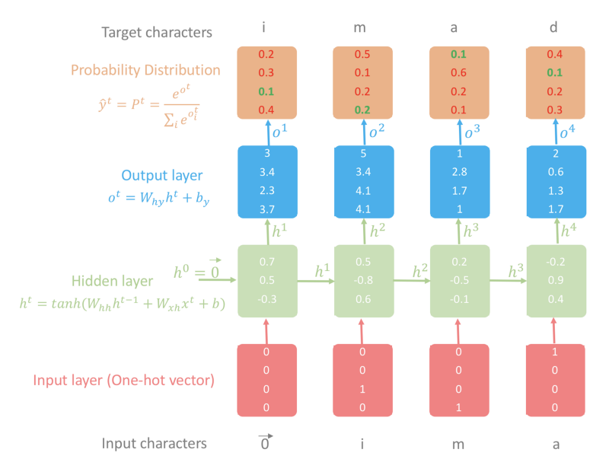
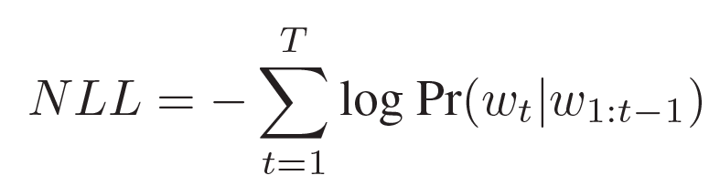
https://towardsdatascience.com/character-level-language-model-1439f5dd87fe
Notes:
Character rnn’s just take characters as input
Maximize green
By: minimize NLL wrt all params, update them opposite direction of gradient
Training by backpropagation through time

Slide 8
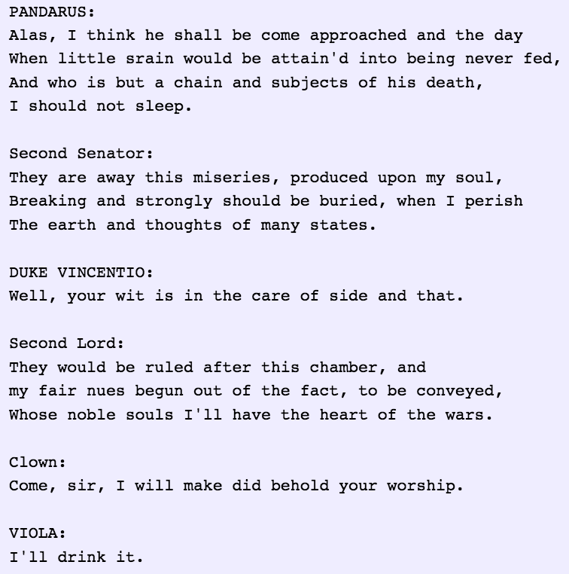
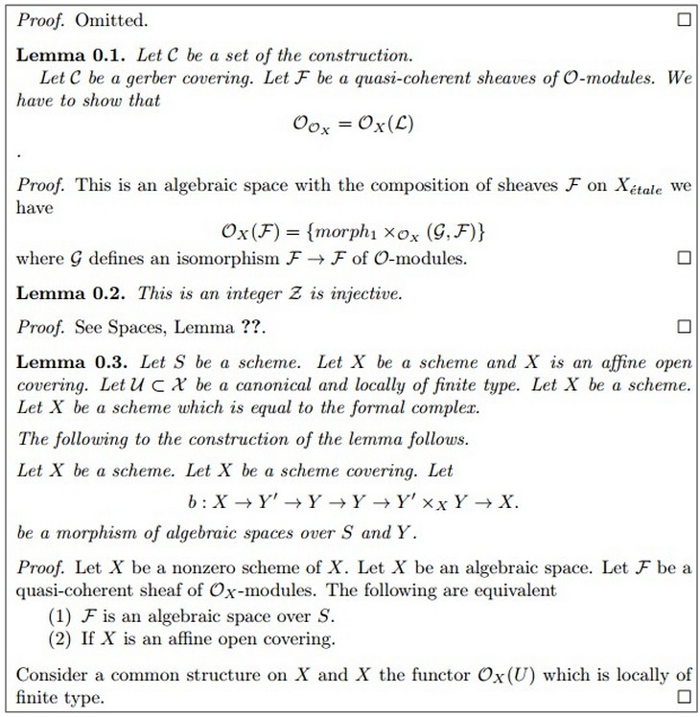
Karpathy’s RNN’s
(Karpathy)
Notes:
Karpathy does character-level RNN’s

Slide 9
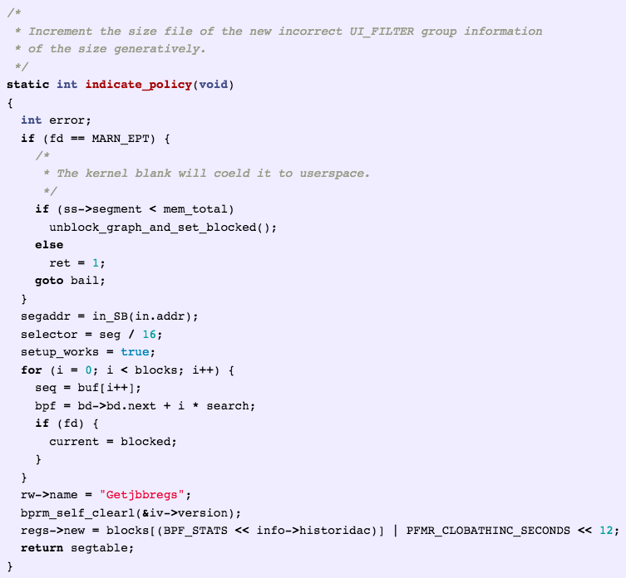
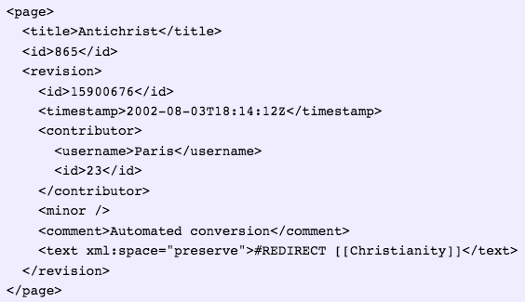
http://karpathy.github.io/2015/05/21/rnn-effectiveness/

Slide 10
But, how?
Training iteration 100:
Training iteration 500:
Training iteration 2000:
Notes:
Mumbo jumbo
Short words
Semi-coherent sentences

Slide 11
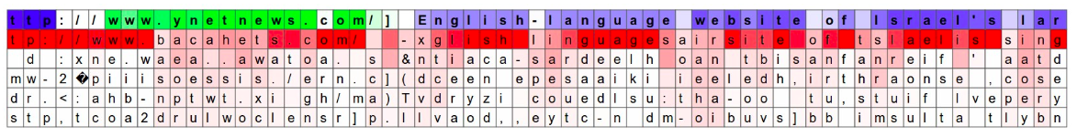
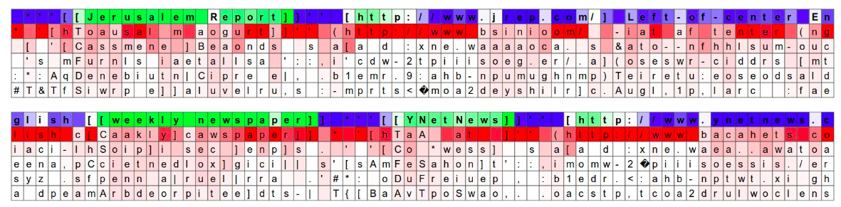
Visualizing neuronal “filters”
Notes:
At lowest level, neurons detect “n-grams”
Pick a random neuron and record activation
Red indicates confident; green indicates high firing activity

Slide 12
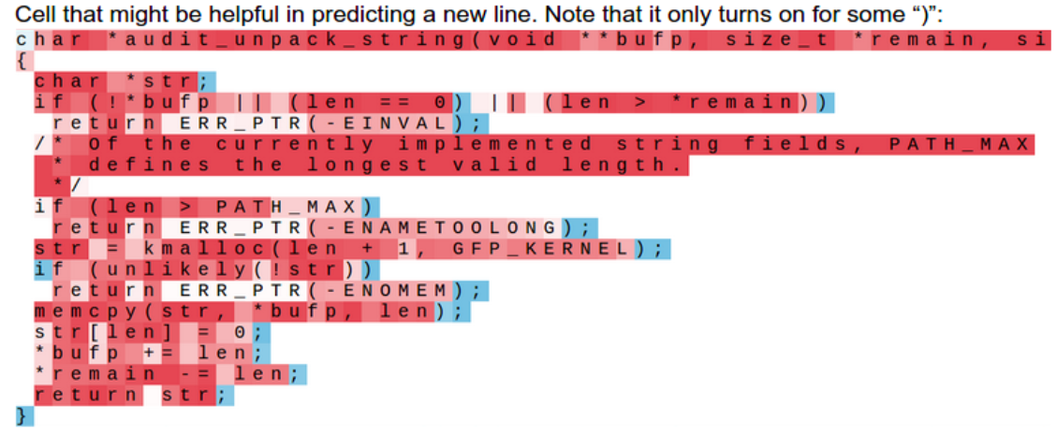
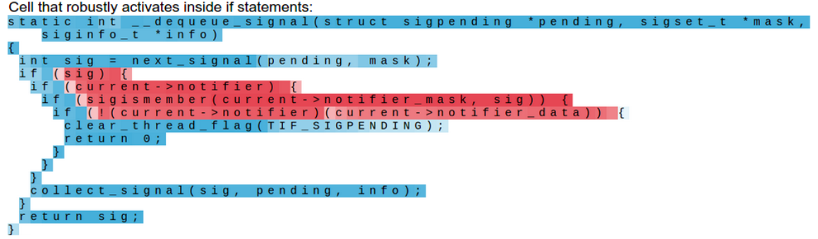
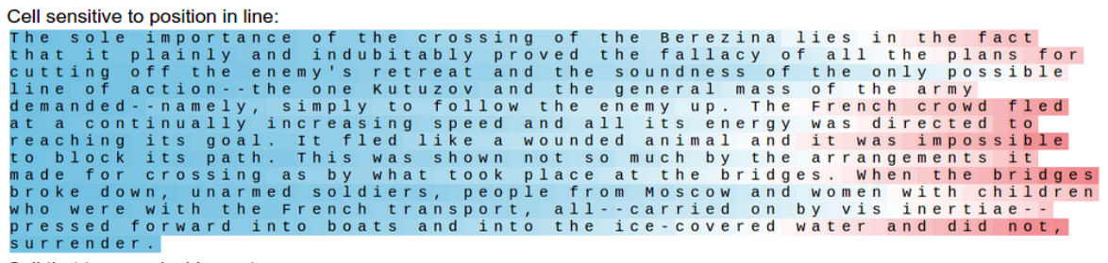
Notes:
Illustrates power of deep learning - no need to hardcode to know if inside a quote

Slide 13
Also in
Neural machine translation
Question answering
Morphological tagging
Parsing

Slide 14
Paper 1: Character-aware neural language models
Yoon Kim, Yacine Jernite, David Sontag, Alexander M. Rush
AAAI 2016
Notes:
Not SOTA, but its key idea influenced all future architectures, including most notably Google’s LM1B

Slide 15
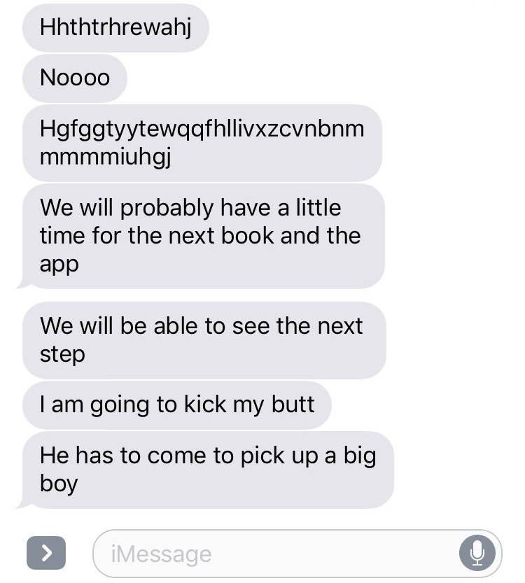
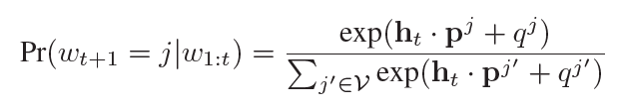
Recap: Language modeling
Probability distribution over a sequence of strings
Pr(w1,w2, … ,wn)
RNN language models minimize negative log-likelihood
(NLL)
Problems with word-level language models
{eventful, eventfully, uneventful, uneventfully}
Lookup table is ginormous!
OOV words
Notes:
Expand probability for neural language models to conditional
Affine transformation (h dot p), followed by a softmax
Cell phones - good to have small model

Slide 16
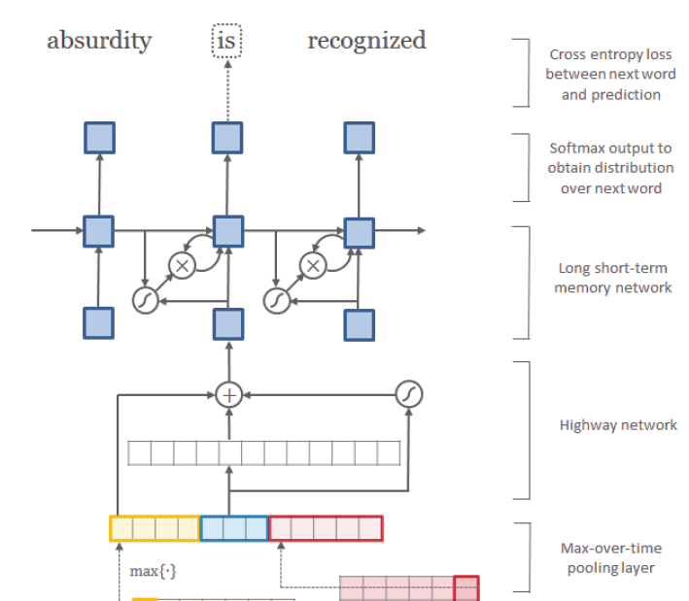
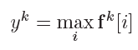
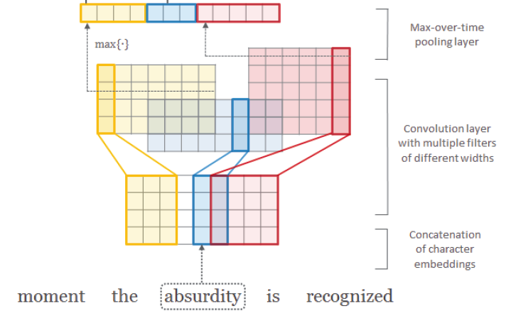
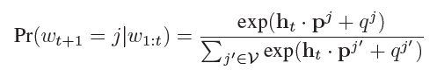
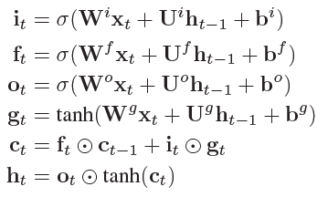
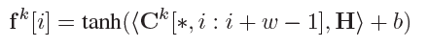
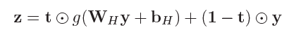
char-CNN + word-LSTM hybrid
word!
Notes:
Forward pass:
Character embeddings of dimension 4 (dense, not one-hot)
Convolution: 12 filters in this case - they detect character n-grams.
Max pooling over time: detects max feature activation for that filter within a feature map, over time. Filter looks for n-grams.
Highway network: like MLP but adaptively carries some information from input to output
LSTM equations: pay attention to c(t)
Probability by applying an affine transformation, followed by softmax to the output

Slide 17
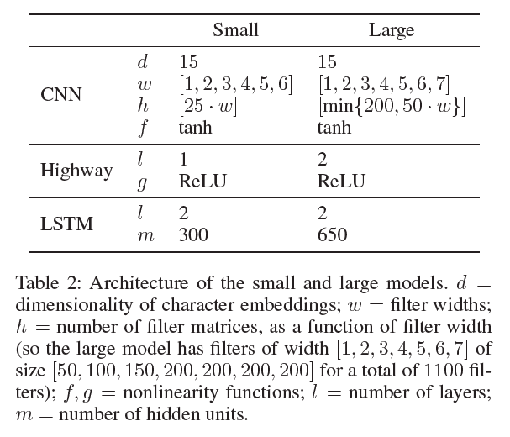
Two model architectures
Notes:
Large: 2 highway layers, more hidden layer nodes, more LSTM hidden units

Slide 18
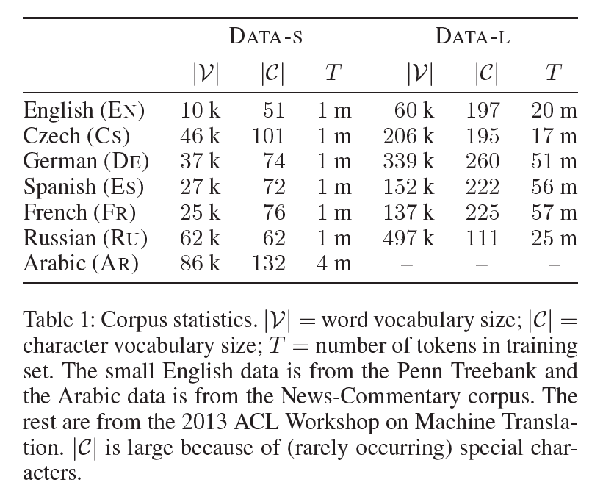
Data
No OOV used, for the sake of comparison
Hyperparameter tuning on PTB
Own train/val/test splits
Notes:
We train on both the small datasets (DATA -S ) with 1 m tokens per language, and the large datasets (DATA -L ) including the large English data
which has a much bigger |V| than the PTB. Arabic from news.
At least 20x more tokens in large.

Slide 19
Training
GPU’s with 2GB memory
Truncated backpropagation through time: 35 time steps SGD
Learning rate initially set to 1.0 and halved if PPL does not decrease by more than 1.0 on the validation set after an epoch.
Parameters randomly initialized over [−0.05, 0.05] .
Dropout (p = 0.5) on the LSTM input-to-hidden layers
Gradient clipping to 5
Hierarchical softmax
Notes:
Truncated BPTT is computationally efficient, but biased toward short-term dep.

Slide 20
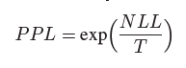
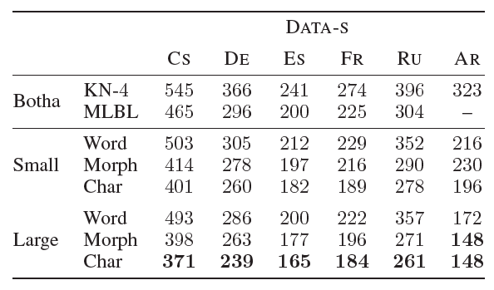
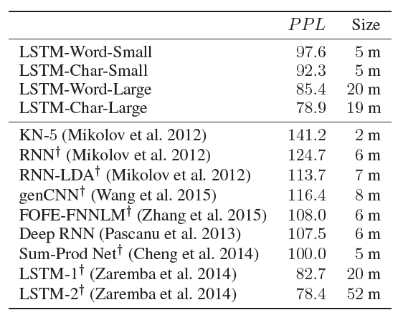
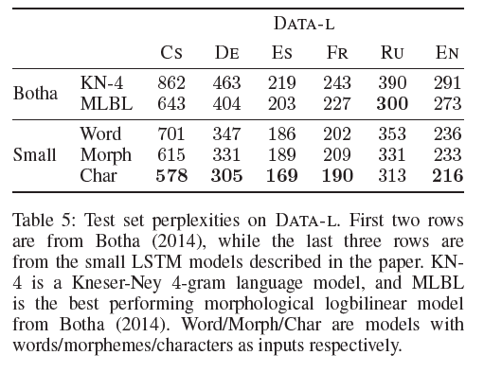
Results
Notes:
T is the number of tokens
Left: English Penn Treebank: On par with the existing state-of-the-art (Zaremba et al. 2014), despite having approximately 60% fewer parameters (lookup of input embeddings)
Right:
More interesting, morphological languages
Baseline: Botha: morphemes, but requires preprocessing.
char model significantly outperforms other NLM’s of similar size. Morphologically rich languages: better to model characters than morphemes or words.
Even fewer parameters with large datasets than 60%

Slide 21
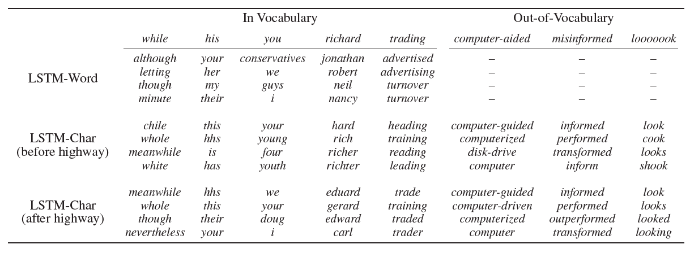
Interpreting word embeddings
Notes:
Knn in embedding space
Before highway - more about word composition. After highway - semantics!
OOV: Corrects misspelled words, good for text normalization!

Slide 22
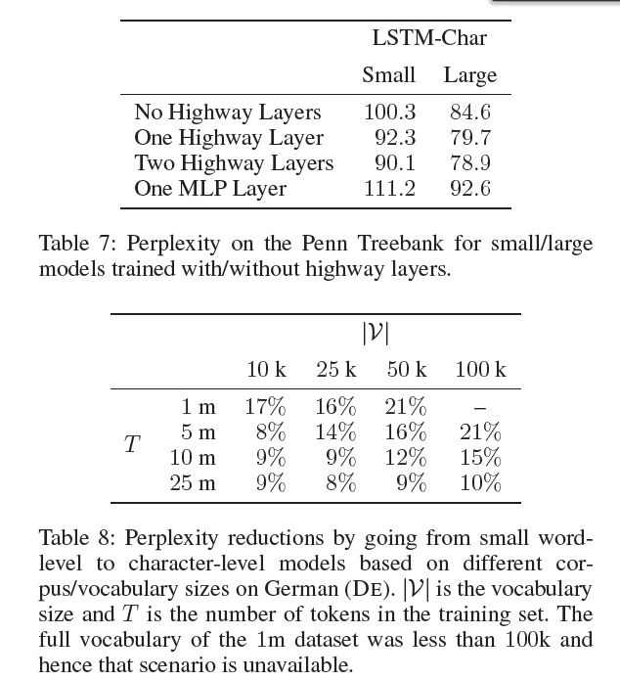
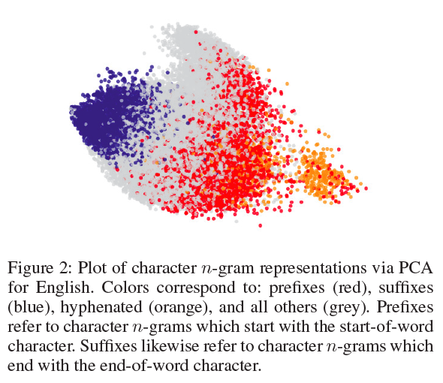
Visualizing learned filters
Notes:
What n-grams are learned? PCA to plot n-grams
Effect of highway: Ablation study without highway layers
Effect of vocab size: (unk) char is better at all sizes

Slide 23
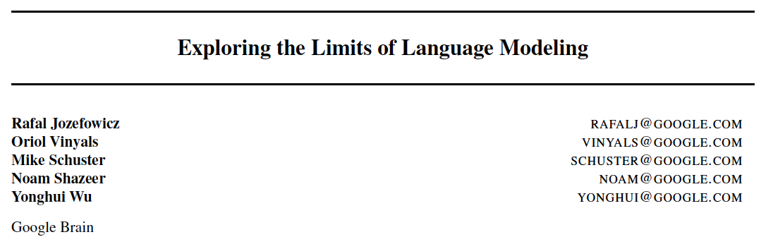
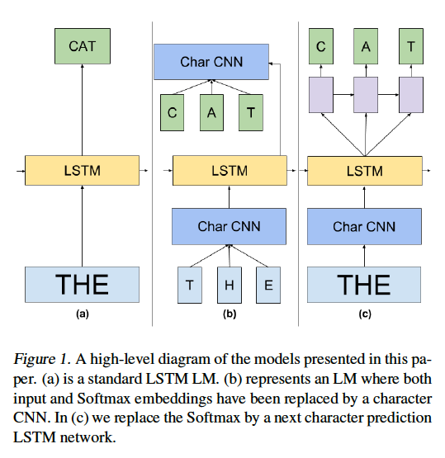
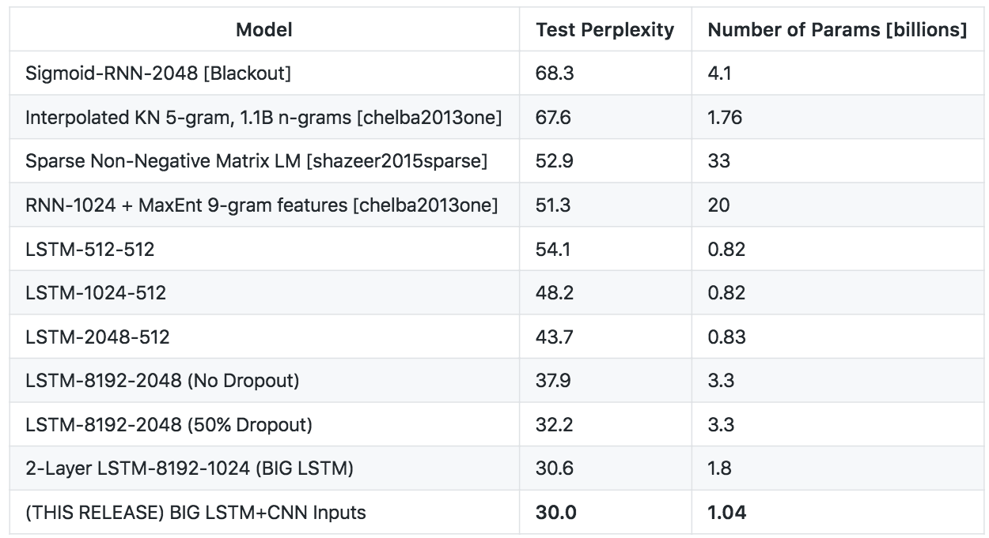
Highlight: Future work inspired
Notes:
Kim - 20m tokens English, perplexity = 80; here, 1b tokens English, perplexity = 30
1 billion params

Slide 24
Conclusions
Neural language model that only uses char-level inputs
Fewer parameters (why?), outperforms baseline models
“Our work questions the necessity of word embeddings (as inputs) for neural language modeling.”
“It would be interesting to see if the architecture introduced in this paper is viable for other tasks—for example, as an encoder/decoder in neural machine translation”

Slide 25
Paper 2: Fully character-level neural machine translation without explicit segmentation
Jason Lee, Kyunghyun Cho, Thomas Hofmann
ACL 2017

Slide 26
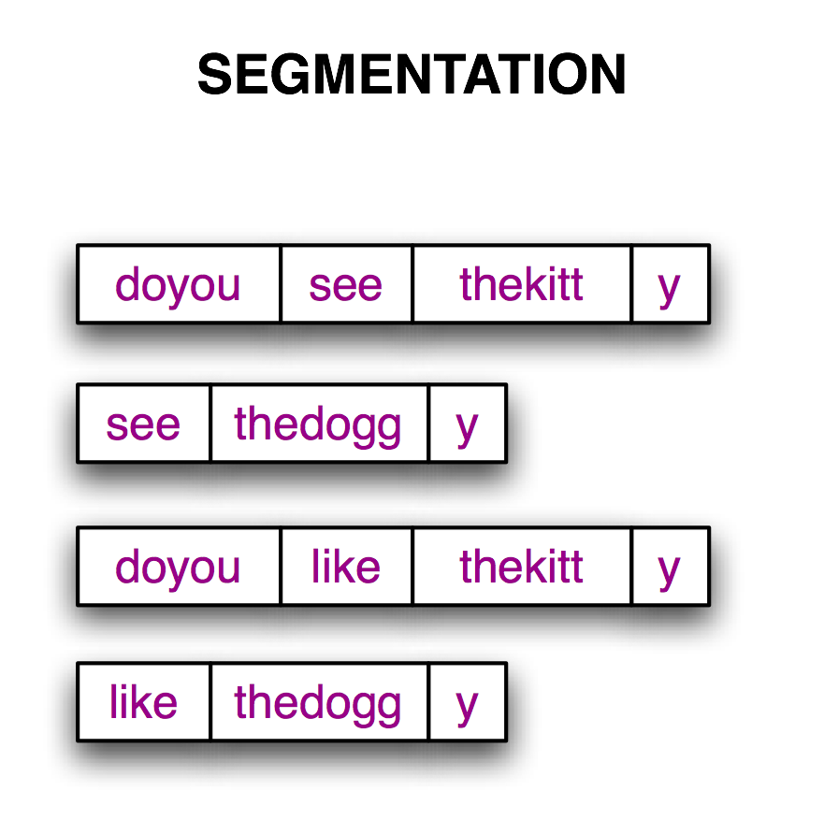
Motivation
Character NMT for:
Model rare words in morphologically rich languages like Czech, Finnish, and Turkish.
Removing vocabulary.
No need to to segment input stream into tokens.
Multilingual translation
Model learns word boundaries.
https://www.nltk.org/book/ch03.html

Slide 27
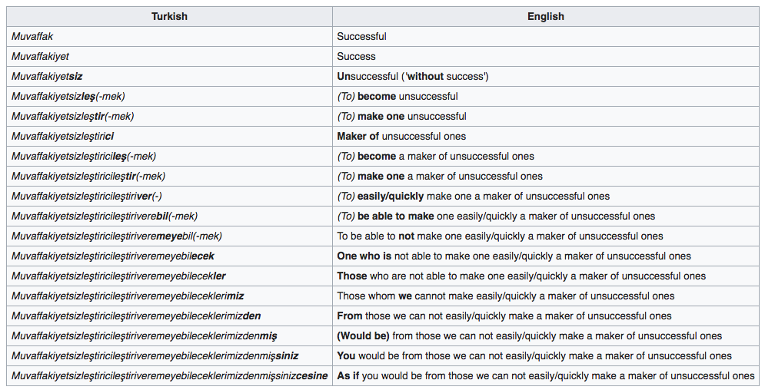
We are in a teachers' training school that has evil purposes. The teachers who are being educated in that school are being taught how to make unsuccessful ones from students. So, one by one, teachers are being educated as makers of unsuccessful ones. However, one of those teachers refuses to be maker of unsuccessful ones, in other words, to be made a maker of unsuccessful ones; he talks about and criticizes the school's stand on the issue. The headmaster who thinks every teacher can be made easily/quickly into a maker of unsuccessful ones gets angry. He invites the teacher to his room and says "You are talking as if you were one of those we can not easily/quickly turn into a maker of unsuccessful ones, right?"
(https://en.wikipedia.org/wiki/Longest_word_in_Turkish)

Slide 28
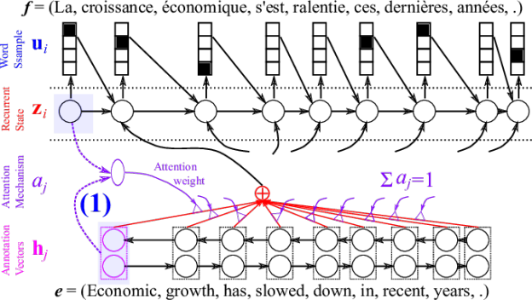
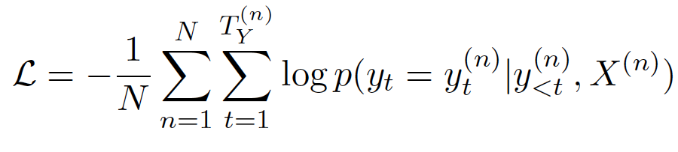
Background: NMT with encoder, decoder, attention
https://devblogs.nvidia.com/introduction-neural-machine-translation-gpus-part-3/
Notes:
Encoder: bidirectional RNN
Attention: dot product: weighted sum of source hidden states for each target step
Decoder: conditional probability distribution of next token

Slide 29
Challanges
Computational complexity - especially for attention, O(s*t)
Much harder to get semantics from characters
Very long range dependencies
Need some way to “shorten” source sentence...

Slide 30
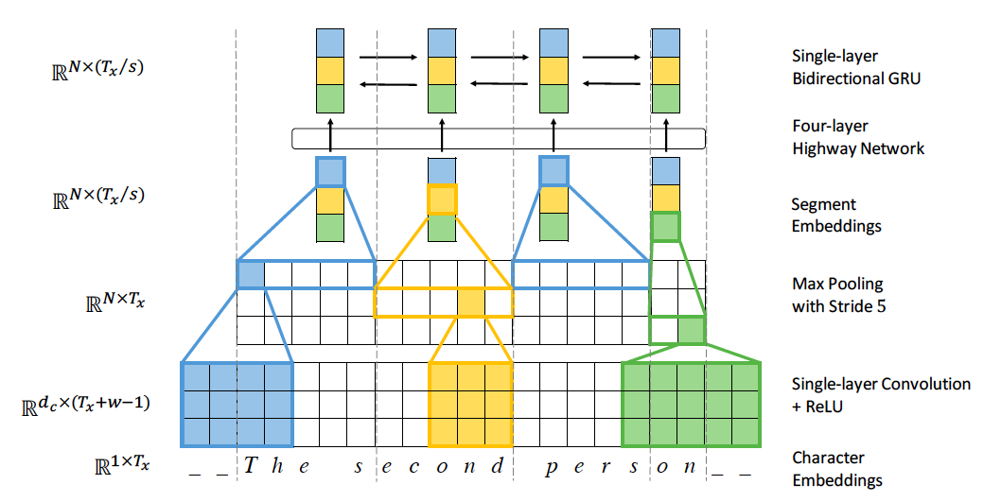
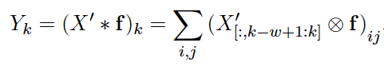
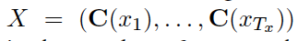
Encoder mechanism (aggressive convolution + max pooling!)
DYNAMIC
Notes:
Part between the two red lines does this. Only differences to word encoders.
Dynamic
Lookup chars
Convolution with filters of various widths, followed by RELU
Max pooling creates segments, which become unit of linguistic meaning, worked on by attention. s=5 here.
Highway network regulating information flow
GRU as the recurrent unit

Slide 31
Attention & Decoder mechanism
Attention: single-layer feedforward network
Computes Context vector mapping each source segment to next target character
Decoder: 2-layer, 1024 GRU’s
Predicts target character from attention context vector

Slide 32
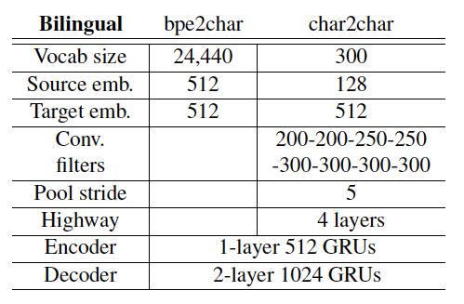
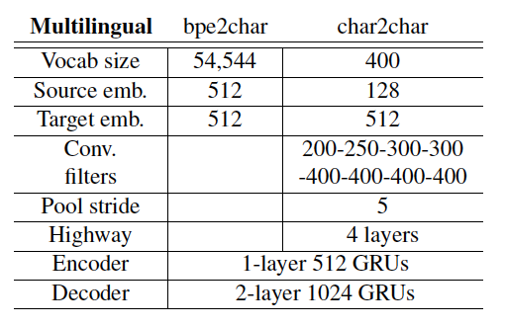
Data
EMNLP2015 WMT: DE → EN, CS → EN, FI → EN and RU → EN tasks
Current: char2char; baselines: bpe2bpe; bpe2char
(subword have already been shown to outperform word)
Multilingual translation
Seamless switching - no token identifier
Notes:
Multilingual is slightly more complicated than bilingual

Slide 33
Training
Stochastic gradient descent and Adam
Learning rate 0.0001 and minibatch size 64
Training until BLEU performance on the validation set stops improving
The norm of the gradient is clipped with a threshold of 1
All weights initialized from a uniform distribution [-0.01; 0.01]
Training on a single pre-2016 GTX Titan X GPU with 12GB RAM.

Slide 34
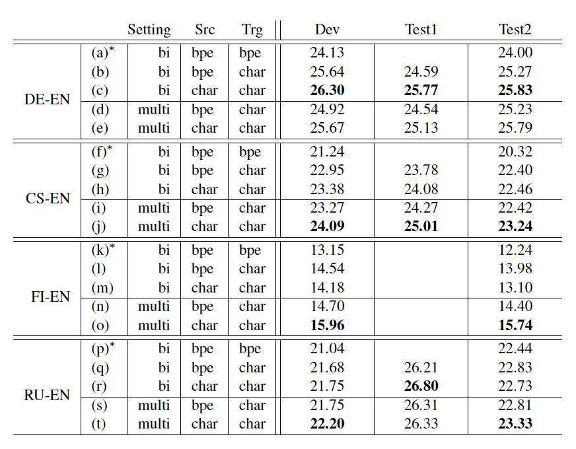
Results
Shown:
BLEU score
(matching n-grams)
Omitted:
Human eval
Notes:
Char >= bpe
Bilingual: always better than bpe2bpe, similar to bpe2char
Multilingual: always best
Multi > bilingual but only for char
Learning useful subword segmentations difficult for BPE
Multilingual char2char > others: it is possible to get better performance with one mode
Human eval: multilingual models better at fluency

Slide 35
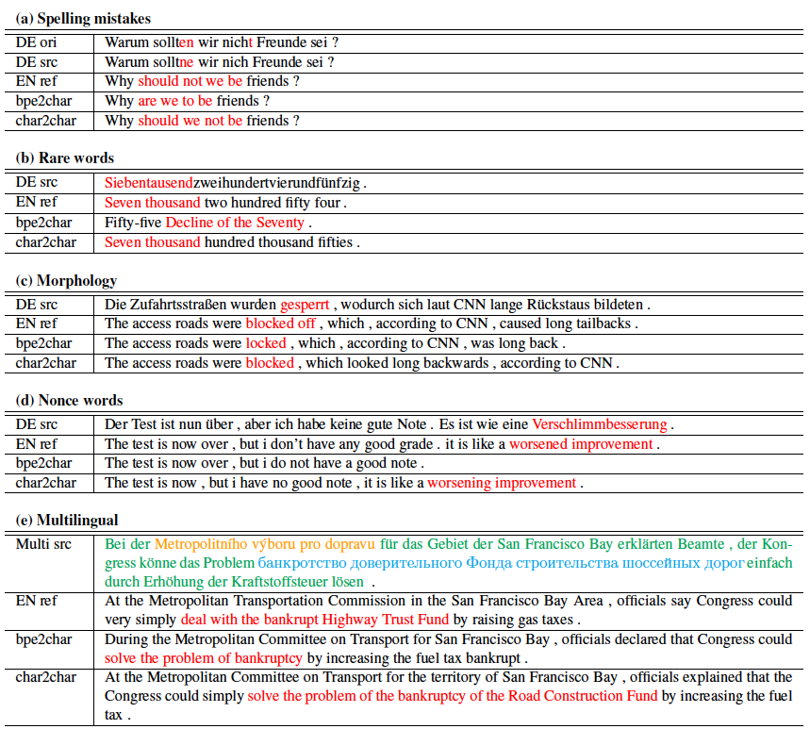
Notes:
Rare words incorrectly segmented
Nonce words are words coined for a single use - “workoliday”
Multilingual more seamless - eg. remembers the “simply” and Trust Fund

Slide 36
Conclusions
First fully-character level NMT model.
No hard-coding word boundaries. Concepts learned on the task alone!
Multilingual models are much more parameter efficient. Universal translation.
Pretrained models released: https://github.com/nyu-dl/dl4mt-c2c

Slide 37
Paper 3: Character-level Convolutional Networks for Text Classification
Xiang Zhang, Junbo Zhao, Yann LeCun
NIPS 2015

Slide 38
Motivation
To date, all text classification has been word level
ConvNets useful in extracting information from raw signals
A sequence of characters is a “raw signal”!
ConvNets do not require domain knowledge of the words / syntax / semantics of a language
“Universal document interpreter”
¯\_(ツ)_/¯ ( ͡° ͜ʖ ͡°) ಠ_ಠ
Notes:
Abnormal

Slide 39
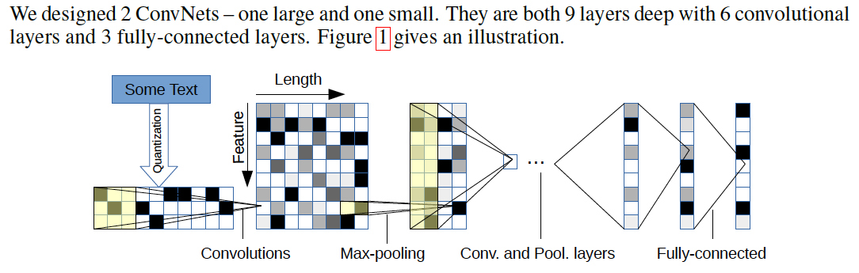
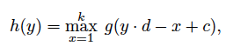
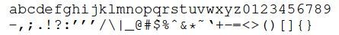


CNN Architecture
Notes:
Unlike Paper 1, character-embeddings are one-hot
Input matrix is 70-by-1014

Slide 40
Training
2 Tesla K40 GPUs
SGD with a minibatch size 128, using momentum 0.9 and initial step size 0.01, halved every 3 epoches 10 times
2 dropout (p = 0.5) modules between the 3 FC’s for regularization

Slide 41

Comparison models
Word-based Conv-net
Multinomial logistic regression on:
Bag-of-words
Bag-of-ngrams
Bag-of-means
LSTM
Notes:
BOW: counts of 50,000 most frequent words as features
BON: counts of 500,000 most frequent ngrams as features
BOM: 5000 clusters over word vectors that appear 5+ times

Slide 42

Data

Slide 43

Results:
test errors
Notes:
Bag-of-means does the worst
Larger datasets → ConvNets do better
Full: lower and uppercase different. Generally worse.

Slide 44
Conclusions
Purely character-level ConvNets are effective.
ConvNets are significantly better for large datasets.
Performs across different task semantics (eg. sentiment vs topic classification).
Bag-of-means is terrible.
Best algorithm depends on dataset.

Slide 45
Discussion questions
For what tasks is it better to use pure word-level?
Text generation is hot. Are char-LSTM’s the way to go?
What are some guidelines / constraints for deciding the appropriate level?
Follow up: when should we prioritize dataset size versus performance for tasks like language modeling?
Notes:
1. Good, interpretable words. Since generally lower perplexity.
2. Not clear. But advantage: less assumptions from pre-training.
3. Language, task (eg. speech recognition)
4. Memory on mobile phones

Slide 46
Question: why did Paper 1 remain at word level? This leads us to...
Paper 4: Character-level language modeling with hierarchical RNN’s
Kyuyeon Hwang and Wonyong Sung
IEEE 2017
Notes:
Only briefly.

Slide 47
Motivation
Can we get the best of both worlds?
 | Character | Word
Good | Simple inputs and outputs | Usually outperforms
Bad | Sequences are too long | Need a huge vocabulary, and billions of parameters

Slide 48

External clock signal
Traditional LSTM equations:
“Resetting” the context:
Notes:
RNN updates only when ct=1
RNN resets when when rt=1
What resets the context? The next layer.
This helps lower layer focus on short term dependencies

Slide 49

Notes:
Opposite to Paper 1: now word level informs character level
Both layers of char module receive a 1-hot char vector
Both direct and indirect route, so LSTM layers work together and are conditioned by the context vector from word RNN

Slide 50
Only source of context
Model is trained to generate context vector that contains useful info about p(next word)
Word LM informs character LM (why?)

Slide 51
Training
Truncated backpropagation through time (BPTT), since all equations are differentiable
No regularization method / dropout employed.
Training is accelerated using GPUs by training multiple sequences in parallel

Slide 52

Experiments
Wall Street Journal (WSJ) corpus (37m words, 1% test)
One Billion Word Benchmark (0.8b words, 800k unique)
End-to-end speech recognition on WSJ
CLMs have fewer parameters, so they can be employed for real-time character-level beam search
Evaluation metric:

Slide 53


Notes:
WSJ:
HLSTM-B network with the size of 4x512 has about 9% lower perplexity than deep LSTM (4x1024) model, even with only 29% of parameters.
Good to KN 5-gram, which is a strong baseline.
Resetting is important
1B
Bigger much better
Beats Kneser but not Google!

Slide 54


https://medium.com/corti-ai/ctc-networks-and-language-models-prefix-beam-search-explained-c11d1ee23306
Notes:
Character LM’s have fewer params, so can be used to char-level beam search
Beat character level baseline, while using much fewer params.

Slide 55
Conclusions
HRNN consists of several submodules with different clock rates → can learn long-term dependencies and short-term details
Significantly outperforms KN5 with 2% of params
Real time automatic speech recognition
Can handle OOV words

Slide 56
Discussion questions
For what tasks is it better to use pure word-level?
Text generation is hot. Are char-LSTM’s the way to go?
What are some guidelines / constraints for deciding the appropriate level?
Follow up: when should we prioritize dataset size versus performance for tasks like language modeling?
Notes:
1. “Normal” text. Since generally lower perplexity.
2. Not clear. But advantage: less assumptions from pre-training, can use weird words.
3. Language morphology, task (eg. speech recognition / informal) more OOV
4. Memory on mobile phones

